Slide 1
Module 5
Implementing IPv4
Notes:
Presentation: 60 minutes
Lab: 45 minutes
After completing this module, students will be able to:
Describe the TCP/IP protocol suite.
Describe IPv4 addressing.
Determine a subnet mask necessary for supernetting or subnetting.
Configure IPv4 and troubleshoot IPv4 communication.
Required Materials
To teach this module, you need the Microsoft® Office PowerPoint® file 20410D_05.pptx.
Important: We recommend that you use Office PowerPoint 2007 or a newer version to display the slides for this course. If you use PowerPoint Viewer or an earlier version of Office PowerPoint, all the features of the slides might not display correctly.
Preparation Tasks
To prepare for this module:
Read all of the materials for this module.
Practice performing the demonstrations and the lab exercises.
Work through the Module Review and Takeaways section, and determine how you will use this section to reinforce student learning and promote knowledge transfer to on‑the‑job performance.
20410D
5: Implementing IPv4

Slide 2
Module Overview
Overview of TCP/IP Understanding IPv4 Addressing Subnetting and Supernetting Configuring and Troubleshooting IPv4
Notes:
Provide a brief overview of the module content.
20410D
5: Implementing IPv4

Slide 3
Lesson 1: Overview of TCP/IP
The TCP/IP Protocol Suite Protocols in the TCP/IP Suite TCP/IP Applications What Is a Socket?
Notes:
Briefly describe the lesson content.
20410D
5: Implementing IPv4

Slide 4
The TCP/IP Protocol Suite
TCP/IP Protocol Suite
Application
HTTP FTP SMTP
DNS POP3 SNMP
Transport
TCP UDP
IPv4
IPv6
Internet
ARP
IGMP
ICMP
Network Interface
Ethernet
Wi-Fi
Mobile broadband
Notes:
Describe the four layers of the TCP/IP protocol suite. Stress the generic functionality that each layer provides. The specific protocols that exist in each layer are discussed in the next topic.
If you think it is necessary, describe to students what each acronym means.
20410D
5: Implementing IPv4

Slide 5
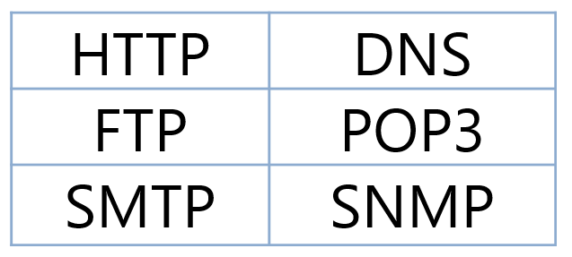
Protocols in the TCP/IP Suite
OSI
TCP/IP
TCP/IP Protocol Suite
Application
Presentation
Session
Application
Transport
Transport
TCP
UDP
Internet
IPv4
IPv6
Network
ARP
IGMP
ICMP
Data Link
Network Interface
Ethernet
Wi-Fi
Mobile broadband
Physical
Notes:
If students are familiar with the Open Systems Interconnection (OSI) model for networking, you can use it as a reference point when discussing the specific protocols in the TCP/IP suite. If students are not already familiar with the OSI model, there is little benefit in spending time on it. Instead, describe the specifics of what each protocol in the transport and Internet layers does. Common application layer protocols are described in the next topic.
20410D
5: Implementing IPv4

Slide 6
TCP/IP Applications
Some common application layer protocols:
HTTP
HTTPS
FTP
RDP
SMB
SMTP
POP3
Notes:
Students should understand that protocols specific to Microsoft, such as Remote Desktop Protocol (RDP) and Server Message Block (SMB), are also application layer protocols. Many students may have seen the application layer presented only in the context of Internet-specific protocols such as HTTP.
20410D
5: Implementing IPv4

Slide 7
What Is a Socket?
A socket is a combination of an IP address, a transport protocol, and a port
TCP/IP Protocol Suite
HTTP (80)
HTTPS (443)
POP3 (110)
SMTP (25)
DNS (53)
FTP (21)
TCP/UDP
IPv4
IPv6
Notes:
Ask students if they are familiar with any other well‑known ports that may be important. Write them on the board, and then discuss the programs that use these ports.
Question
Are there other well‑known ports that you can think of?
Answer
Other well-known ports include:
RDP. TCP 3389
Kerberos protocol. TCP/UDP 88
Remote procedure call (RPC). TCP/UDP 135
Internet Message Application Protocol (IMAP). TCP 143
Microsoft SQL Server® TCP 1433
20410D
5: Implementing IPv4

Slide 8
Lesson 2: Understanding IPv4 Addressing
IPv4 Addressing Public and Private IPv4 Addresses How Dotted Decimal Notation Relates to Binary Numbers Simple IPv4 Implementations More Complex IPv4 Implementations
Notes:
Provide a brief overview of the lesson content.
20410D
5: Implementing IPv4

Slide 9
IPv4 Addressing
Each networked computer must be assigned a unique IPv4 address
Network communication for a computer is directed to the IPv4 address of the computer
Each IPv4 address contains:
Network ID, identifying the network
Host ID, identifying the computer
The subnet mask identifies which part of the IPv4 address is the network ID (255) and which is the host ID (0)
IP address | 172 | 16 | 0 | 10
Subnet mask | 255 | 255 | 0 | 0
Network ID | 172 | 16 | 0 | 0
Host ID | 0 | 0 | 0 | 10
Notes:
There are three static slides in this topic.
Slide 1 of 3
Question
How is network communication affected if a default gateway is configured incorrectly?
Answer
A host with an incorrect default gateway is unable to communicate with hosts on a remote network. Communication on the local network is unaffected.
20410D
5: Implementing IPv4

Slide 10
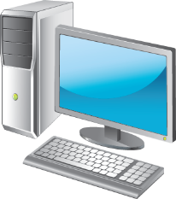
IPv4 Addressing
An IPv4 configuration identifies a computer to other computers on a network
Subnet 1
IP Address: 192.168.1.180 Subnet mask: 255.255.255.0
IP Address: 192.168.1.182 Subnet mask: 255.255.255.0
IP Address: 192.168.1.181 Subnet mask: 255.255.255.0
Dotted decimal representation of the address and subnet mask
Notes:
Slide 2 of 3
Discuss this slide with students before clicking through to the first subnet. Emphasize that each computer has the same first 3 octets in their IP addresses. Talk about the dotted decimal notation for IPv4 binary numbers.
20410D
5: Implementing IPv4

Slide 11
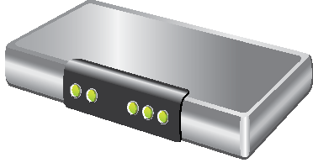
IPv4 Addressing
An IPv4 configuration identifies a computer to other computers on a network
Subnet 1
IP Address: 192.168.1.180 Subnet mask: 255.255.255.0
IP Address: 192.168.1.182 Subnet mask: 255.255.255.0
IP Address: 192.168.1.181 Subnet mask: 255.255.255.0
Dotted decimal representation of the address and subnet mask
Default gateway defines the preferred router
Subnet 2
IP Address: 192.168.2.200
Subnet mask: 255.255.255.0
IP Address: 192.168.2.202 Subnet mask: 255.255.255.0
IP Address: 192.168.2.201 Subnet mask: 255.255.255.0
Notes:
Slide 3 of 3
Discuss the difference in IP addresses for the computers in Subnet 2.
20410D
5: Implementing IPv4

Slide 12

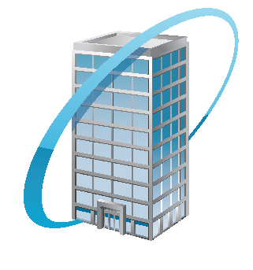
Public and Private IPv4 Addresses
Public
Private
Required by devices and hosts that connect directly to the Internet
Must be globally unique
Routable on the Internet
Must be assigned by IANA/RIR
Not routable on the Internet
10.0.0.0/8
172.16.0.0/12
192.168.0.0./16
Can be assigned locally by an organization
Must be translated to access the Internet
Notes:
Most students have a basic understanding of how computers connect to the Internet and how network address translation (NAT) is used. However, if you think it is necessary, take a few moments and explain how NAT allows multiple computers to share a single public IP address. Also, explicitly mention the private IP address ranges.
Students may be interested to know that some private organizations were originally allocated large class A networks in the public IPv4 address space. In many cases, unused portions of these originally allocated networks have been returned to the RIR for reallocation.
20410D
5: Implementing IPv4

Slide 13
How Dotted Decimal Notation Relates to Binary Numbers
Dotted decimal notation is based on the decimal number system, but computers use IP addresses in binary
Within an 8‑bit octet, each bit position has a decimal value:
A bit that is set to 0 always has a zero value
A bit that is set to 1 can be converted to a decimal value
The low‑order bit represents a decimal value of 1
The high‑order bit represents a decimal value of 128
If all bits in an octet are set to 1, then the octet’s decimal value is 255, the highest possible value of an octet:
128 + 64 + 32 + 16 + 8 + 4 + 2 + 1
Notes:
There are four static slides for this topic.
Slide 1 of 4
Work through the example in this topic to ensure that students understand the basic concept of binary numbers and how they can be converted to dotted decimal notation. Show students how to perform this calculation by using the calculator included with the Windows® operating system.
Briefly explain how to convert binary numbers to dotted decimal notation manually. Use the following three slides to show how to convert an 8-bit octet from a binary number to a decimal number.
20410D
5: Implementing IPv4

Slide 14
How Dotted Decimal Notation Relates to Binary Numbers
8-Bit Octet
Bit 7
Bit 6
Bit 5
Bit 4
Bit 3
Bit 2
Bit 1
Bit 0
Notes:
Slide 2 of 4
20410D
5: Implementing IPv4

Slide 15
How Dotted Decimal Notation Relates to Binary Numbers
8-Bit Octet
Bit 7
Bit 6
Bit 5
Bit 4
Bit 3
Bit 2
Bit 1
Bit 0
2⁷
2⁶
2⁵
2⁴
2³
2²
2¹
2⁰
Notes:
Slide 3 of 4
20410D
5: Implementing IPv4

Slide 16
How Dotted Decimal Notation Relates to Binary Numbers
8-Bit Octet
Bit 7
Bit 6
Bit 5
Bit 4
Bit 3
Bit 2
Bit 1
Bit 0
2⁷
2⁶
2⁵
2⁴
2³
2²
2¹
2⁰
128
64
32
16
8
4
2
1
Decimal Value
Notes:
Slide 4 of 4
20410D
5: Implementing IPv4

Slide 17
Simple IPv4 Implementations
Class A (/8) Large Network
Network ID
Host ID
0
w
x
y
z
Class B (/16) Medium
Network
Network ID
Host ID
1 0
w
x
y
z
Class C (/24) Small Network
Network ID
Host ID
1 1 0
w
x
y
z
Notes:
Emphasize to students that knowing the class of an IP address is useful for identifying a likely subnet mask. However, if subnetting has been performed, then the default subnet mask is not valid.
Simple IPv4 networking is defined by using only 255 or 0 in the subnet mask. This is not a technical definition, just recognition that when you have a large network such as the 10.0.0.0/8 network, working with only 255 or 0 in the subnet mask is easier. It will not be possible to do this in all scenarios.
20410D
5: Implementing IPv4

Slide 18
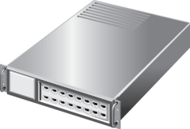

More Complex IPv4 Implementations
172.16.16.0/22
172.16.17.0/24
172.16.20.0/22
172.16.17.1
172.16.24.0/22
172.16.18.0/24
172.16.16.0/20
172.16.17.254
172.16.28.0/22
Notes:
Do not discuss the details of how to determine the subnet mask. The next lesson covers that topic. The key concept in this topic is that subnet masks can have values other than 255 or 0. Make sure that students understand variable length subnet masks, because they will use them in the lab.
Question
Does your organization use simple or complex networking?
Answer
Answers will vary. Most small organizations use simple networking to make configuration easier. Larger organizations with networking specialists are more likely to use complex networking.
20410D
5: Implementing IPv4

Slide 19
Lesson 3: Subnetting and Supernetting
How Bits Are Used in a Subnet Mask or Prefix Length The Benefits of Using Subnetting Calculating Subnet Addresses Calculating Host Addresses Discussion: Creating a Subnetting Scheme for a New Office What Is Supernetting?
Notes:
Provide a brief overview of the lesson content.
20410D
5: Implementing IPv4

Slide 20
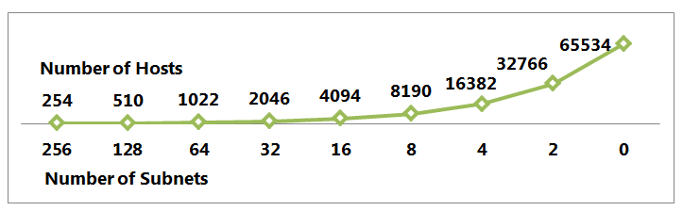
How Bits Are Used in a Subnet Mask or Prefix Length
Class B Address with Subnet
1 0
1 0
1 0
1 0
1 0
1 0
1 0
1 0
1 0
Network ID
Network ID
Network ID
Network ID
Network ID
Network ID
Network ID
Network ID
Network ID
Subnet ID
Subnet ID
Subnet ID
Subnet ID
Subnet ID
Subnet ID
Subnet ID
Subnet ID
Subnet ID
Host ID
Host ID
Host ID
Host ID
Host ID
Host ID
Host ID
Host ID
Host ID
1
2
4
8
16
32
64
128
256
65534
32766
16382
8190
4094
2046
1022
510
254
Notes:
This build slide requires only one click to start and to play the entire animation.
Use the slide animation to help describe the relationship between the number of subnets and the number of hosts. Emphasize to students that when a subnet mask is expressed in binary notation, a 1 represents a bit in the network ID, and a 0 represents a bit in the host ID. Relate this to the 255 and 0 that are used in simple networks. Also, relate the number of bits to CIDR notation and prefix length, which defines the number of bits in the network address.
The following is a list of the bits used on the build slide, and the corresponding number of subnets and hosts:
8 bits – 256 subnets, 254 hosts
7 bits – 128 subnets, 510 hosts
6 bits – 64 subnets, 1,022 hosts
5 bits – 32 subnets, 2,046 hosts
4 bits – 16 subnets, 4,094 hosts
3 bits – 8 subnets, 8,190 hosts
2 bits – 4 subnets, 16,382 hosts
1 bit – 2 subnets, 32,766 hosts
0 bits – 1 subnets, 65,534 hosts
20410D
5: Implementing IPv4

Slide 21
The Benefits of Using Subnetting
When you subdivide a network into subnets, you create a unique ID for each subnet that is derived from the main network ID
By using subnets, you can:
Use a single network address across multiple locations
Reduce network congestion by segmenting traffic
Increase security by using firewalls
Overcome limitations of current technologies
Notes:
Use this topic to explain to students why they may want to subnet their network. This provides a context for the following topics, and explains why the process for performing subnetting is important.
20410D
5: Implementing IPv4

Slide 22
Calculating Subnet Addresses
When determining subnet addresses you should:
Choose the number of subnet bits based on the number of subnets required
Use 2^{n} to determine the number of subnets available from n bits
For five locations, the following three subnet bits are required:
5 locations = 5 subnets required
2² = 4 subnets (not enough)
2³ = 8 subnets
Notes:
Although there is a mathematical way to solve for the number of bits required to support a given number of networks, it is easier to substitute a number into the formula until you find a number of bits that works for your organization. You can also use the table provided in the student handbook.
20410D
5: Implementing IPv4

Slide 23
Calculating Host Addresses
When determining host addresses you should:
Choose the number of host bits based on the number of hosts that you require on each subnet
Use 2^{n}-2 to determine the number of hosts that are available on each subnet
For subnets with 100 hosts, seven host bits are required:
2⁶-2 = 62 hosts (not enough)
2⁷-2 = 126 hosts
Notes:
Make sure that students understand why the minus 2 is part of the formula 2^{n}‑2. The minus removes the addresses for the network and broadcasts. Note that a default gateway is also required, and is not removed during this calculation.
20410D
5: Implementing IPv4

Slide 24

Discussion: Creating a Subnetting Scheme for a New Office
How many subnets are required?
How many bits are required to create that number of subnets?
How many hosts are required on each subnet?
How many bits are required to support that number of hosts?
What is an appropriate subnet mask that would satisfy these requirements?
20 minutes
Notes:
Discuss the questions on the slide with students.
Question
How many subnets are required?
Answer
Five subnets are required in this scenario. Of these, four subnets are required for buildings, and one is required for the data center.
Question
How many bits are required to create that number of subnets?
Answer
Three bits are required to create five subnets, because three bits allow for eight subnets. Because printers in this scenario have networking capability, you assign IP addresses to them.
Question
How many hosts are required on each subnet?
Answer
Because each subnet must support 700 users and 14 printers, 714 hosts are required on each subnet.
Question
How many bits are required to support that number of hosts?
Answer
Ten bits are required to support up to 1,022 hosts.
Question
What is an appropriate subnet mask that would satisfy these requirements?
Answer
Several subnet masks can allow for the minimum number of networks and the minimum number of hosts:
255.255.224.0 (3 subnet bits, 13 host bits)
255.255.240.0 (4 subnet bits, 12 host bits)
255.255.248.0 (5 subnet bits, 11 host bits)
255.255.252.0 (6 subnet bits, 10 host bits)
20410D
5: Implementing IPv4

Slide 25
What Is Supernetting?
Supernetting combines multiple small networks into a larger network
The networks that you combine must be contiguous
The following table shows an example of supernetting two class C networks
Network | Range
192.168.00010000.00000000/24 | 192.168.16.0 - 192.168.16.255
192.168.00010001.00000000/24 | 192.168.17.0 - 192.168.17.255
192.168.00010000.00000000/23 | 192.168.16.0 - 192.168.17.255
Notes:
Use the table on the slide to show students that supernetting reduces the network identification (ID) by one bit, and increases the host ID by one bit. The decimal equivalents for the subnet masks are:
/24 = 255.255.255.0
/23 = 255.255.254.0
20410D
5: Implementing IPv4

Slide 26
Lesson 4: Configuring and Troubleshooting IPv4
Configuring IPv4 Manually Configuring IPv4 Automatically Using Windows PowerShell Cmdlets to Troubleshoot IPv4 IPv4 Troubleshooting Tools The IPv4 Troubleshooting Process What Is Microsoft Message Analyzer? Demonstration: How to Capture and Analyze Network Traffic by Using Microsoft Message Analyzer
Notes:
Briefly review the lesson content.
20410D
5: Implementing IPv4

Slide 27
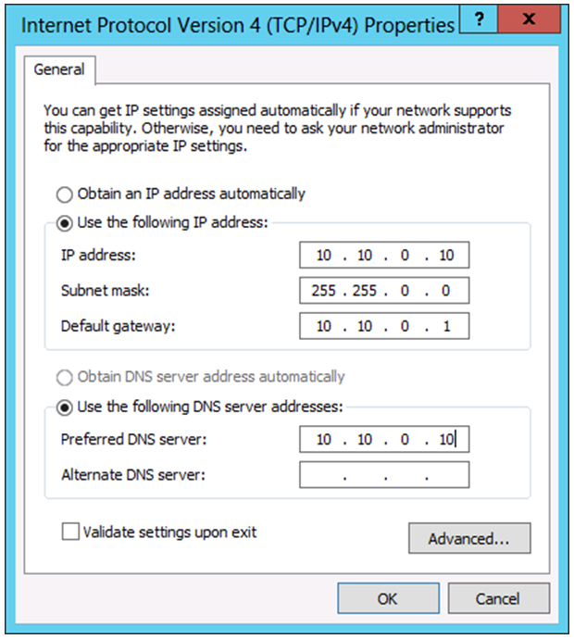
Configuring IPv4 Manually
Notes:
There are two static slides in this topic.
Slide 1 of 2
Students should already be familiar with configuring an IP address. However, if you feel that it would benefit them, you can demonstrate the process.
Question
Do any computers or devices in your organization have static IP addresses?
Answer
In most cases, servers have static IP addresses. Other network devices such as printers also typically have static IP addresses.
20410D
5: Implementing IPv4

Slide 28
Configuring IPv4 Manually
Examples using Windows PowerShell cmdlets:
New-NetIPAddress –InterfaceAlias “Local Area Connection” –IPAddress 10.10.0.10
‑PrefixLength 24 –DefaultGateway 10.10.0.1
Set-DNSClientServerAddresses –InterfaceAlias “Local Area Connection”
–ServerAddresses 10.12.0.1,10.12.0.2
Example using the netsh command-line tool:
Netsh interface ipv4 set address name="Local Area Connection" source=static addr=10.10.0.10 mask=255.255.255.0 gateway=10.10.0.1
Notes:
Slide 2 of 2
Demonstrate how to manage IP address configuration settings by using Windows PowerShell cmdlets.
20410D
5: Implementing IPv4

Slide 29
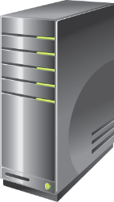
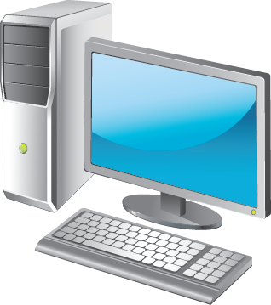
Configuring IPv4 Automatically
DHCP Server with IPv4 Scope
IPv4 DHCP Client
Set-NetIPInterface –InterfaceAlias "Local Area Connection" –Dhcp Enabled
Restart-NetAdapter –Name "Local Area Connection"
Notes:
Try not to get into too much detail when discussing DHCP. Focus on the client configuration portion of DHCP. A later module covers DHCP in more detail.
Explain the examples to students so that they can see how to use Windows PowerShell® to configure DHCP. Explain the difference between the Windows PowerShell cmdlets for NetAdapter and NetIPInterface:
A network adapter represents a physical network card in your computer. This is the equivalent to viewing network connections from Server Manager in Windows Server® 2012.
A network IP interface is a protocol binding to a network adapter.
20410D
5: Implementing IPv4

Slide 30
Using Windows PowerShell Cmdlets to Troubleshoot IPv4
New Windows PowerShell cmdlets include:
Get-NetAdapter
Restart-NetAdapter
Get-NetIPInterface
Get-NetIPAddress
Get-NetRoute
Get-NetConnectionProfile
Get-DNSClientCache
Get-DNSClientServerAddress
Register-DnsClient
Set-DnsClient
Set-DnsClientGlobalSetting
Set-DnsClientServerAddress
Set‑NetIPAddress
Set‑NetIPv4Protocol
Set‑NetIPInterface
Test-Connection
Test-NetConnection
Resolve-Dnsname
Notes:
Go through the Windows PowerShell cmdlets that are shown on the slide. As you do, draw parallels between the functionality of the cmdlets and the command-line tools. For example, Get NetIPAddress is similar to Ipconfig without any options, and Get DNSClientCache is similar to Ipconfig /displaydns.
Ask students if they can think of any other cmdlets that may be useful for troubleshooting IPv4.
20410D
5: Implementing IPv4

Slide 31
IPv4 Troubleshooting Tools
Use the following tools to troubleshoot IPv4:
Ipconfig
Ping
Tracert
Pathping
Telnet
Netstat
Resource Monitor
Windows Network Diagnostics
Event Viewer
Notes:
This topic focuses on tools that will help students identify and resolve IP connectivity problems between hosts. A later module discusses name resolution, but you can introduce the concept at this point.
20410D
5: Implementing IPv4

Slide 32
The IPv4 Troubleshooting Process
After you identify the scope of the problem, use the following tools to troubleshoot network connectivity:
Step | Windows PowerShell | Command-line tool
Verify the network configuration is correct | Get-NetIPAddress | ipconfig
Identify the network path between hosts | Test-NetConnection -TraceRoute | tracert
See if the remote host responds | Test-NetConnection | ping
Test the service on a remote host | Test-NetConnection -Port | Telnet
See if the default gateway responds | Test-NetConnection | ping
Notes:
Explain to students that there is no exact process to follow when troubleshooting network connectivity problems. Ask students if they have suggestions other than those listed in this topic.
Question
What additional steps might you use to troubleshoot network connectivity problems?
Answer
Answers will vary. Some students may monitor firewalls if the problem is related to Internet connectivity. Students may also use application logs when troubleshooting connectivity to a specific program.
20410D
5: Implementing IPv4

Slide 33
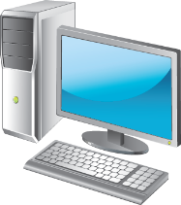


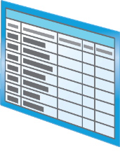






What Is Microsoft Message Analyzer?
You can use Microsoft Message Analyzer to perform the following network analysis tasks:
Capture message data
Save message data
Import message data
View message data
Filter message data
Create charts from captured data
Notes:
Describe Microsoft Message Analyzer in general terms, and explain how students can use it for examining network communication. If necessary, explain how they can use port mirroring to install Microsoft Message Analyzer on a dedicated computer instead of the two computers involved in the communication process. Finally, use the slide to introduce the types of information that Microsoft Message Analyzer displays.
20410D
5: Implementing IPv4

Slide 34
Demonstration: How to Capture and Analyze Network Traffic by Using Microsoft Message Analyzer
In this demonstration, you will see how to:
Start a new Capture/Trace in Microsoft Message Analyzer
Capture packets from a ping request
Analyze the captured network traffic
Filter the network traffic
Notes:
Mention to students that filtering is useful when you want to display only specific packets when troubleshooting a specific problem. For example, you could display only communication with a specific IP address. If students are interested, consider showing the contents of a few more packets, such as ARP packets.
Preparation Step
Start the virtual machines 20410D‑LON‑DC1, 20410D‑LON‑RTR, and 20410D‑LON‑SVR2.
Demonstration Steps
Start a new Capture/Trace in Microsoft Message Analyzer
Sign in to LON‑SVR2 as Adatum\Administrator with a password of Pa$$w0rd.
On the taskbar, click the Windows PowerShell icon.
At the Windows PowerShell prompt, type the following, and then press Enter:
ipconfig /flushdns
On the Start screen, click Microsoft Message Analyzer.
In the Microsoft Message Analyzer dialog box, click Do not update items, and then click OK.
In the navigation pane, click Capture/Trace, and then, in the Trace Scenarios section, click Firewall.
Capture packets from a ping request
In Microsoft Message Analyzer, on the toolbar, click Start With.
At the Windows PowerShell prompt, type the following, and then press Enter:
Test-NetConnection LON‑DC1.adatum.com
3. In Microsoft Message Analyzer, on the toolbar, click Stop.
20410D
5: Implementing IPv4
(More notes on the next slide)

Slide 35
Notes:
Analyze the captured network traffic
In Microsoft Message Analyzer, in the results pane, under the Module column, select the first ICMP packet group.
In the results pane, click the plus sign ‘+’ beside the selected packet group.
Show that the packet group includes both the Echo Request and the Echo Reply packets, due to the ping request that was executed when running the Test-NetConnection cmdlet.
View the source and destination IP addresses for each packet.
Filter the network traffic
On the Microsoft Message Analyzer toolbar, in the View Filter section, in the Filter box, type the following, and then click Apply Filter:
*DestinationAddress == 172.16.0.10
Verify that only packets that match the filter are displayed.
Close Microsoft Message Analyzer.
20410D
5: Implementing IPv4

Slide 36
Lab: Implementing IPv4
Exercise 1: Identifying Appropriate Subnets Exercise 2: Troubleshooting IPv4
Logon Information
Virtual machines 20410D‑LON‑DC1
20410D‑LON‑RTR
20410D‑LON‑SVR2
User name Adatum\Administrator
Password Pa$$w0rd
Estimated Time: 45 minutes
Notes:
Before the students begin the lab, read the lab scenario and display the next slide. Before each exercise, read the scenario associated with the exercise to the class. The scenarios are the context of the lab and exercises, and help to facilitate the discussion at the end of the lab. Remind students to complete the discussion questions after the last lab exercise.
Exercise 1: Identifying Appropriate Subnets
The new branch office is configured with a single subnet. After a security review, all branch office network configurations are being modified to place servers on a separate subnet from the client computers. You need to calculate the new subnet mask and the default gateways for the subnets in your branch.
The current network for your branch office is 192.168.98.0/24. This network needs to be subdivided into three subnets that meet the following requirements:
One subnet with at least 100 IP addresses for clients.
One subnet with at least 10 IP addresses for servers.
One subnet with at least 40 IP addresses for future expansion.
Exercise 2: Troubleshooting IPv4
A server in the branch office is unable to communicate with the domain controller in the head office. You need to resolve the network connectivity problem.
20410D
5: Implementing IPv4

Slide 37
Lab Scenario
You have recently accepted a promotion to the server support team. One of your first assignments is configuring the infrastructure service for a new branch office.
After a security review, your manager has asked you to calculate new subnets for the branch office to support segmenting network traffic. You also need to troubleshoot a connectivity problem on a server in the branch office.
Notes:
20410D
5: Implementing IPv4

Slide 38
Lab Review
Why is variable-length subnetting required in this lab? Which Windows PowerShell cmdlet can you use to view the local routing table of a computer instead of using route print?
Notes:
Lab Review Questions
Question
Why is variable-length subnetting required in this lab?
Answer
The criteria in the scenario call for one subnet with 100 IP addresses for clients. It is not possible to make all of the subnets this large. Variable-length subnetting enables you to subdivide the single /24 network into variable-sized subnets to accommodate one large subnet and two smaller subnets.
Question
Which Windows PowerShell cmdlet can you use to view the local routing table of a computer instead of using route print?
Answer
You can use the Get‑NetRoute cmdlet to view the local routing table of a computer.
20410D
5: Implementing IPv4

Slide 39
Module Review and Takeaways
Review Questions Best Practices Common Issues and Troubleshooting Tips
Tools
Notes:
Module Review Questions
Point the students to the appropriate section in the course so that they are able to answer the questions that this section presents.
Question
You have just started as a server administrator for a small organization with a single location. The organization is using the 131.107.88.0/24 address range for the internal network. Is this a concern?
Answer
Yes, that is a concern because those are Internet‑routable addresses. Most IPv4 networks use private addresses with network address translation (NAT) to allow access to the Internet. This organization will not be able to access the 131.107.88.0/24 network on the Internet.
Question
You are working for an organization that provides web hosting services to other organizations. You have a single /24 network from your ISP for the web hosts. You are almost out of IPv4 addresses and have asked your ISP for an additional range of addresses. Ideally, you would like to supernet the existing network with the new network. Are there any specific requirements for supernetting?
Answer
Yes. To perform supernetting, the two networks must be consecutive. The networks must allow you to remove a single bit from the subnet mask and identify both as the same network.
Question
You have installed a new web‑based program that runs on a non‑standard port number. A colleague is testing access to the new web‑based program, and indicates that he cannot connect to it. What are the most likely causes of his problem?
Answer
When a server program runs on a non‑standard port, you need to provide the client program with the port number to which it should be connecting. For example, http://servername:port. It is also possible that your colleague is attempting to connect using http, when he should be using https.
20410D
5: Implementing IPv4
(More notes on the next slide)

Slide 40
Notes:
Best Practices
When implementing IPv4, use the following best practices:
Allow for growth when planning IPv4 subnets. This ensures that you do not need to change you IPv4 configuration scheme.
Define purposes for specific address ranges and subnets. This enables you to both identify hosts based on their IP address easily and to use firewalls to increase security.
Use dynamic IPv4 addresses for clients. It is much easier to manage the IPv4 configuration for client computers by using DHCP than with manual configuration.
Use static IPv4 addresses for servers. When servers have a static IPv4 address, it is easier to identify where services are located on the network.
Common Issues and Troubleshooting Tips
Common Issue: IP conflicts
Troubleshooting Tip: In most cases, computers that are running Windows operating systems display a message when they have an IP conflict with another network device. However, some network devices do not. When performing a packet capture, duplicate TCP acknowledgements can be an indication that two devices have the same IP address, and that both are responding to connection attempts.
To prevent IP conflicts, clearly document which IPv4 addresses are in use on your network, and do not assign new IPv4 addresses without checking the documentation.
Common Issue: Multiple default gateways defined
Troubleshooting Tip: On hosts with multiple network cards, only one should have a default gateway defined. Windows Server 2012 is designed to function with only a single default gateway. When multiple default gateways are defined, network communication may be unpredictable. You can verify that only a single default gateway is configured by using the Get‑NetRoute cmdlet.
Common Issue: Incorrect IPv4 configuration
Troubleshooting Tip: Incorrect IPv4 configuration information is most commonly a result of a manual configuration error. To ensure that this does not affect a production environment, you should test network connectivity thoroughly for any new servers that you place into production. You should also perform testing after making any network configuration changes.
(More notes on the next slide)
20410D
5: Implementing IPv4

Slide 41
Notes:
Tools
20410D
5: Implementing IPv4

